Slide 1



Noida Institute of Engineering and Technology, Greater Noida
Indian Literature, Culture, Tradition, and Practices
Unit:2
INDIAN TRADITIONS, CULTURE AND SOCIETY
Dr.Ankita Shukla
Department of MBA
Course Details
CH 6th Semester

Slide 2
Index/Content
S. No. | Index
1. | Content
2. | Unit Objective(s)
3. | Course Outcome(s)
4. | CO-PO & PSO Mapping
5. | Requisite & Recap
6. | Objectives of Topic/Session
7. | Topic Mapping with course outcomes
8. | Lecture

Slide 3
Index/Content
S. No. | Index
9. | Video Links
10. | Daily Quiz
11. | MCQs
12. | Assignment
13. | Old Question Papers
14. | Summary
15. | References

Slide 4
Content
Evolution of script and languages in India.
The Vedas, the Upanishads, the Ramayana and the Mahabharata, Puranas,
Buddhist And Jain Literature in Pali, Prakrit And Sanskrit,
Kautilya’s Arthashastra, Famous Sanskrit Authors, Telugu Literature,
Indian Literatures
Persian And Urdu ,Hindi Literature

Slide 5
Unit Objective(s)
Introduction to ancient India scripts and languages
Brief overview on Vedas and Upanishads
Brief overview on Buddhist and Jain Literature

Slide 6
Course Outcome
1. The course aims at imparting basic principles of thought process, reasoning and inference to identify the roots and details of some of the contemporary issues faced by our nation and try to locate possible solutions to these challenges by digging deep into our past.
2. To enable the students to understand the importance of our surroundings and encourage the students to contribute towards sustainable development.
3. To sensitize students towards issues related to ‘Indian’ culture, tradition and its
composite character.
4. To make students aware of holistic life styles of Yogic-science and wisdom capsules in Sanskrit literature that are important in modern society with rapid technological
advancements and societal disruptions.
5. To acquaint students with Indian Knowledge System, Indian perspective of modern
scientific world-view and basic principles of Yoga and holistic health care system.

Slide 7
CO-PO and PSO Mapping
PO CO | PO4 | PO5 | PO6 | PO7 | PO8 | PO9 | PO10 | PO11 | PO12
KNC 602.1 | M |  |  |  |  |  |  |  | M
KNC 602.2 |  |  |  | H | M
KNC 602.3 |  |  |  |  | H |  |  |  | M
KNC 602.4 |  |  |  |  |  | M |  |  | H
KNC 602.5 |  |  |  | M |  |  |  |  | H
Average | 2 |  |  | 2.5 | 2.5 | 2 |  |  | 2.5

Slide 8
Topic Mapping with course outcomes
Unit-I | So. No. | Mapping
 |  | Topic | Course Outcomes
2 | 1 | Evolution of script and languages in India. | CO2
 | 2 | The Vedas, the Upanishads, the Ramayana and the Mahabharata, Puranas | CO2
 | 3 | Indian Literatures Persian And Urdu ,Hindi Literature | CO2

Slide 9
Topic objectives
Students will be able to know the following concepts:
Introduction to ancient India scripts and languages
Brief overview on Vedas and Upanishads
Brief overview on Buddhist and Jain Literature

Slide 10
Harappan Script
The Indus script (also known as the Harappan script) is a corpus of symbols produced by the Indus Valley Civilization.
There is no known bilingual inscription to help decipher the script, and the script shows no significant changes over time.
The first publication of a seal with Harappa symbols dates to 1875, in a drawing by Alexander Cunningham
Generally recognized as the world's expert on the Indus script, Asko Parpola has been studying this undeciphered writing for over 40 years at the University of Helsinki in Finland.

Slide 11
Harappa Script
The two features of Harappa script are –
It was pictographic in nature as the script consisted of designs of animals, fishes and various forms of human figure too.
It was found to be inscribed on seals, terracotta tablets etc

Slide 12
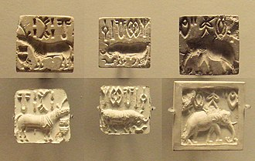
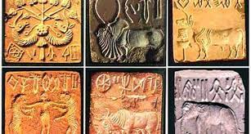
Harappan Script

Slide 13
Brahmi Script
The Brahmi writing system, or script, appeared as a fully developed universal one in South Asia in the third century BCE, and is a forerunner of all writing systems that have found use in South Asia with the exception of the Indus script of the third millennium BCE

Slide 14
Brahmi Script
Brahmi is the originator of most of the present Indian scripts, including Devanagari, Bengali, Tamil, and Malayalam etc.
It developed into two broad types in Northern and Southern India, in the Northern one being more angular and the Southern one being more circular.
It was deciphered in 1838 by James Prinsep.
The best-known Brahmi inscriptions are the rock-cut edicts of Ashoka in north-central India, dated to 250–232 BCE.

Slide 15
Brahmi Script
The Brahmi script confirms to the syllabic writing system and was used more for writing Prakrit, the language spoken by ordinary people initially and later Sanskrit also was written in this script.
According to the epigraphers- All Indian scripts are derived from Brahmi. There are two main families of scripts:
1. Devanagari, which is the basis of the languages of northern and western India: Hindi, Gujarati, Bengali, Marathi, Dogri, Panjabi, etc.
2. Dravidian which shows the formats of Grantha and Vatteluttu.

Slide 16
Vedas & Upanishads
The Vedas ( वेदः vedaḥ, "knowledge") are a large body of religious texts originating in ancient India. Composed in Vedic Sanskrit, the texts constitute the oldest layer of Sanskrit literature and the oldest scriptures of Hinduism.
The Vedas are a collection of hymns and other religious texts composed in India between about 1500 and 1000 BCE.
It includes elements such as mythological accounts, poems, prayers, and formulas considered to be sacred by the Vedic religion.

Slide 17
Vedas Types
1. Rig-Veda “Knowledge of the Hymns of Praise”
2. Sama-Veda “Knowledge of the Melodies”
3. Yajur-Veda “Knowledge of the Sacrificial formulas”
4. Atharva-Veda “Knowledge of the Magic formulas”

Slide 18
RIG-VEDA
The RIG-VEDA “Wisdom of the Verses” Rig Veda consists of 10,552 verses (collected into 10 books) of hymns and mantras used by the priests. It is a collection of 1,028 Vedic Sanskrit hymns and 10,600 verses in all, organized into ten books (Sanskrit: mandalas).
The hymns of the Rig Veda focus on pleasing the principal gods Indra (war, wind and rain), Agni (the sacrificial fire), Surga (the sun) and Varuna (the cosmic order) through ritual sacrifices. the Vedic gods also forgive wrongdoing and mete out justice in the afterlife

Slide 19
SAMA-VEDA
The SAMA-VEDA "Wisdom of the Chants” consisting primarily of selections from the Rig Veda. The Samaveda Samhita consists of 1549 stanzas, taken almost entirely (except for 75 mantras) from the Rigveda.
The Samaveda samhita has two major parts. The first part includes four melody collections (gāna, गान) and the second part three verse “books” (ārcika, आर्चिक)

Slide 20
YAJUR-VEDA
The YAJUR-VEDA “Wisdom of the Sacrifical Formulas" liturgical works consisting primarily of selections from the Rig Veda.
The Yajurveda Samhita consists of prose mantras. It is a compilation of ritual offering formulas that were said by a priest while an individual performed ritual actions such as those before the yajna fire.
The earliest and most ancient layer of Yajurveda includes about 1,875 verses, that are distinct yet borrow and build upon the foundation of verses in Rigveda.
Unlike the Samaveda which is almost entirely based on Rigveda mantras and structured as songs, the Yajurveda samhitas are in prose and linguistically, they are different from earlier Vedic texts.
The Yajur Veda has been the primary source of information about sacrifices during Vedic times and associated rituals

Slide 21
ATHARVA-VEDA
The ATHARVA-VEDA “Wisdom of the Magical Formulas" Was added significantly later than the first three Samhitas, perhaps as late as 500 BC.
It consists of 20 books of hymns and prose, many of which reflect the religious concerns of everyday life. It has about 760 hymns, and about 160 of the hymns are in common with the Rigveda
The Samhita layer of the text likely represents a developing 2nd millennium BCE tradition of magico-religious rites to address superstitious anxiety, spells to remove maladies believed to be caused by demons, and herbs- and nature-derived potions as medicine
The Atharva veda has been a primary source for information about Vedic culture, the customs and beliefs, the aspirations and frustrations of everyday Vedic life, as well as those associated with kings and governance. The text also includes hymns dealing with the two major rituals of passage – marriage and cremation.

Slide 22
Upanishads
The term Upanishad means literally "those who sit near". Upa- near, ni- down, sad- to sit: Sitting near the teacher
Collected by several seers and elders between 800-500 BCE, the Upanishads are a conclusion and accomplishment of an previous form of Hindu sacred texts called the Vedas.
Upanishads are Vedanta: End of the Vedas

Slide 23
Upanishads
Most Important Upanishads
Brhadaranyaka Upanishad
Chandogya Upanishad
Taittiriya Upanishad
Aitereya Upanishad
Kausitaki Upanishad
Kena Upanishad
Katha Upanishad
Isha Upanishad
Svetasvatara Upanishad
Mundaka Upanishad
Prashna Upanishad
Maitri Upanishad
Mandukya Upanishad

Slide 24
Upanishads
Human intellect is not an adequate tool to understand the immense complexity of reality.
The Upanishads do not claim that our brain is entirely useless; it certainly has its use.
• The highest understanding, according to this view, comes from direct perception and intuition.
The Upanishads tell us that the core of our own self is not the body, or the mind, but atman or “Self”.

Slide 25
Central Concepts of Upanishads
1. Brahman was recognized as incomprehensible to a human being, which is why It could only be apprehended even somewhat through the avatars of the Hindu gods, but was also understood as the Source of Life which had given birth to humanity (essentially each person's father and mother).
Recognition of a higher self within the self – the Atman
3. The goal of life, then, is self-actualization – to become completely aware of and in touch with one's higher self – so that one could live as closely as possible in accordance with the Eternal Order of the Universe and, after death, return home to complete union with Brahman.
4. The transmigration of souls (reincarnation) was considered a given in that, if a person failed to perform their dharma in one life, their karma (past actions) would require them to return to try again. This cycle of rebirth and death was known as samsara and one found liberation (moksha) from samsara through the self-actualization which united the Atman with Brahman.

Slide 26
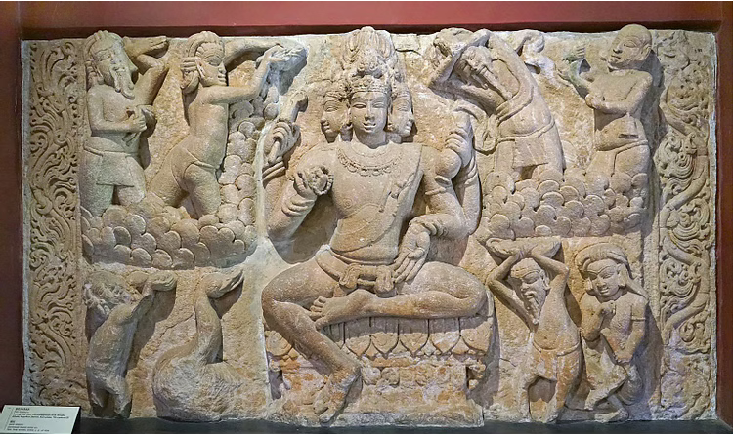
The Brahma

Slide 27
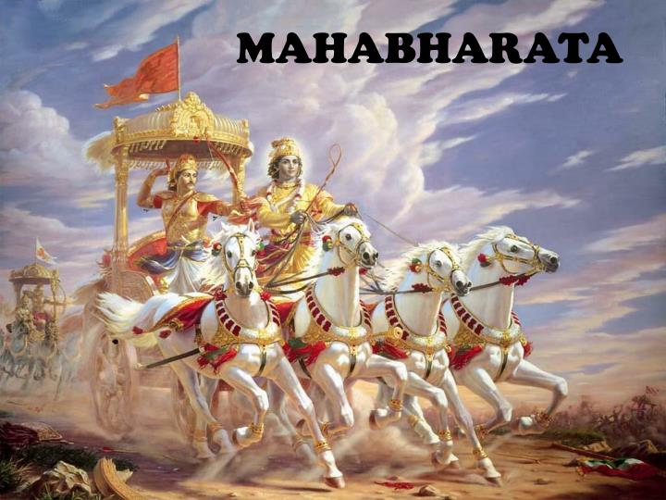
The Ramayana & The Mahabharata

Slide 28
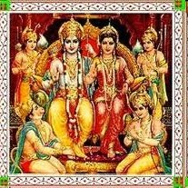
Why are the epics important?
▪
The Ramayana and the Mahabharata are considered the foundation of dharma or the Hindu code of ethical existence.
Duty to parents, brotherly love, true friendship, correct conduct, courage, persistence and many other virtues are stressed in the epics.
They are also entertaining stories because they are full of action and adventure.
▪
▪

Slide 29
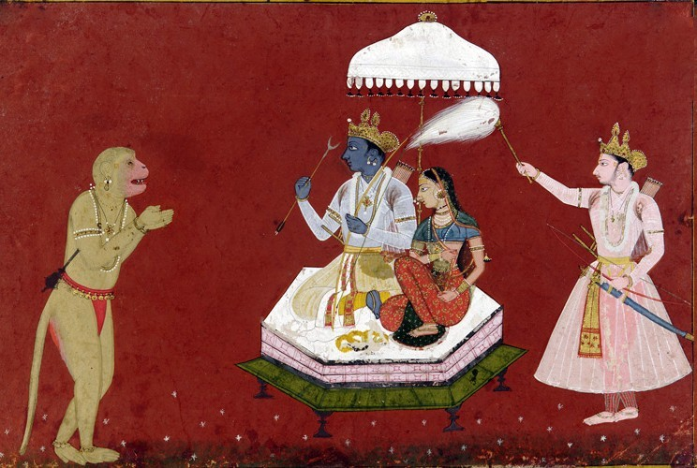
The Ramayana
•
The story of Rama, the incarnation of Vishnu and the ideal man (maryada purushottam)
Supposed to have been written some time between 500 B.C. and 100 B.C.
Ramayana literally means ‘Rama’s journey’. It is called ‘Adi Kavya,’ the first and ideal poem.
It was composed in Sanskrit by Valmiki, who is also called ‘Adi Kavi’ or the first poet.
It consists of 24,000 verses in seven books called kandas.
•
•
•
•

Slide 30
The Ramayana
1. Bala Kanda
2. Ayodhya Kanda
3. Aranya Kanda
4.Kishkindha Kanda
5.Sundara Kanda
6.Yuddha Kanda
7. Uttara Kanda

Slide 31
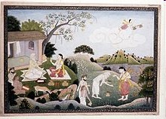
How the Ramayana was Written
•
Valmiki was a robber who repented of his crimes. He asked sage Narada who the perfect man was. Narada replied, “Rama,” and narrated the story of Rama.
Valmiki became preoccupied with thoughts of Rama.
Once he saw a hunter’s arrow killing a male bird.
The cries of the female bird touched Valmiki’s heart, who cursed the hunter.
His words formed a shloka, a piece of verse that could be sung to music.
•
•
•
•

Slide 32
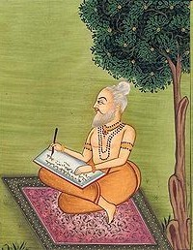
The first poem in Sanskrit
•
This shloka was the first poem in Sanskrit.
Later Brahma the creator appeared to Valmiki saying “Tell the story of Rama in the same metre and rhyme. I’ll grant you a vision of his whole life. And as long as the mountains and seas remain, so will the glorious Ramayana live in the hearts of men and inspire them to perform noble deeds.”
He taught it first to Rama’s sons, Luv and Kush then his other disciples.
•
•

Slide 33
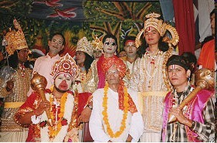
How did the Ramayana become popular?
•
Story tellers and bards narrated or sang it to people and soon it spread through the country.
It was retold in many Indian languages and even entered the culture of neighbouring countries.
It also entered the realm of music, dance and theatre and to this day is performed as the Rama Lila during the festival of Dusshera which celebrates Rama’s battle and victory against the demon king Ravana.
•
•

Slide 34
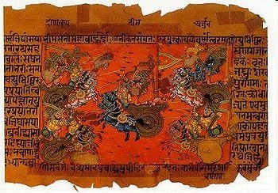
The Mahabharata
•
The Mahabharata is a more complex work which covers almost every aspect of life and living.
It is the longest existing epic consisting of 1,20,000 shlokas.
Said to be the story of an ancient battle between two branches of a family, the Bharatas.
Said to be composed around 400 B.C.
•
•
•

Slide 35
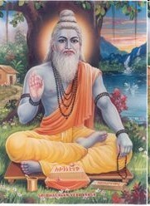
Who wrote the Mahabharata?
•
Also known as Jaya or victory, the Mahabharata is said to have been composed by the great sage Vyasa, the compiler of the Vedas.
Vyasa taught the Mahabharata to his son Suka.
It is said Narada taught it to the gods or devas while Suka taught it to the gandharvas, the rakshasas and the yakshas.
Vaisampayana, one of Vyasa’s chief disciples, narrated the story at a great sacrifice conducted by Janamejaya, the descendent of the Pandavas and it spread further.
•
•
•

Slide 36

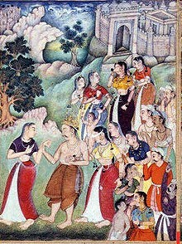

How is the story of the battle
told?
•
It is in the form of a dialogue between King Dhritarashtra and Sanjaya his advisor and chariot driver.
Sanjaya narrates each incident of the Kurukshetra War, fought in 18 days, as and when it happened.
Dhritarashtra sometimes asks questions and laments the destruction caused by the war, to his sons, friends and kinsmen. He also feels guilty, because he was partly responsible.
Sanjaya begins with a description of the earth, the other planets, and gives an elaborate list of the kingdoms, tribes, provinces, cities, towns, villages, rivers, mountains, forests, etc. of Bharatavarsha.
He also explains the military formations adopted on each day, the death of each hero and the details of each battle.
•
•
•
•

Slide 37
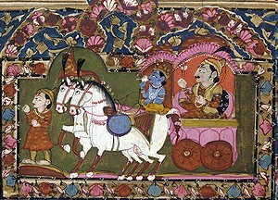
The Bhagwad Gita
•
The Bhagwad Gita, one of the most sacred texts of the Hindus, constitutes some 18 chapters of the Mahabharata.
The Gita is the conversation between Lord Krishna and Arjuna before the battle of Kurukshetra.
Arjuna wonders if it is right to fight his own cousins, and Krishna explains his duties as a warrior and prince to him and the importance of appropriate action.
This has led to the Gita often being described as a practical guide to life and living.
Krishna stressed that the soul is immortal and the body perishable.
He finally reveals his identity as the Supreme Being Himself and blesses Arjuna with an awe-inspiring vision.
•
•
•
•
•

Slide 38
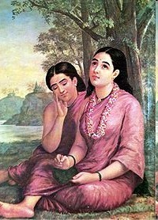
Mahabharata in art and
literature
Stories from the Mahabharata have inspired great works of art and literature like Kalidasa’s play Abhigyana Shakuntalam on the story of Shakuntala, and Raja Ravi Verma’s paintings.
Bhima’s slaying of the demon Bakasura, the righteous and truth loving Raja Harishchandra, the Akshayapatra or the wondrous vessel of plenty, Nala and Damayanti, Agastya and Lopamudra are other popular stories from the Mahabharata.
•

Slide 39
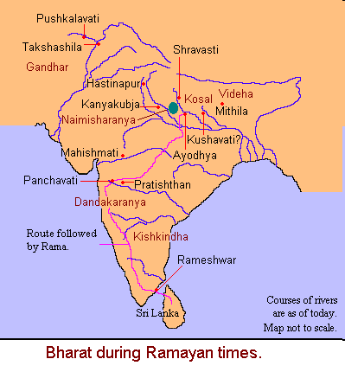
Where the Ramayana took place
•
Ayodhya—Rama’s city, capital of Kosala
Videha—kingdom of King Janak, Sita’s father
Panchavati—Lakshman cut off Surpanakha’s nose here
Dandakaranya forest—Sita was abducted from here
Kishkindha—Sugriva’s kingdom
Rameshwar—the place from where Rama crossed to Lanka
Sri Lanka—Ravana’s kingdom
•
•
•
•
•
•

Slide 40
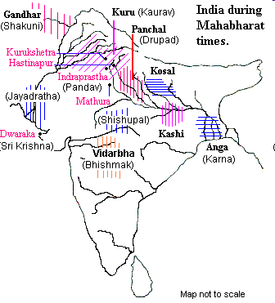
Where the Mahabharata took
place
Indraprastha—Pandav capital
Hastinapur—Kaurav capital
Gandhar—Gandhari’s home
Kurukshetra—the battlefield
Panchal—Draupadi’s home
Dwarka—Krishna’s kingdom
Anga—Karna’s kingdom
•
•
•
•
•
•

Slide 41
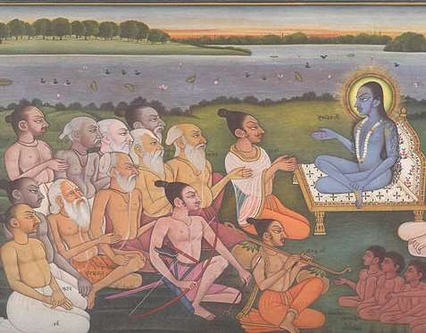
What are the Puranas ?
Purana is a Sanskrit word that means "ancient" or "old." It is a genre of ancient Indian literature found both in Hinduism and Jainism.
Literature of Vedic tradition.
Written almost entirely in narrative couplets.
Earliest written versions were compiled during the Gupta empire.

Slide 42
What are the Puranas ?
Puranas are encyclopedic texts that cover various topics such as cosmogony, cosmology, folk tales, pilgrimages, temples, medicine, astronomy, grammar, mineralogy, humor, love stories, theology and philosophy as well as the genealogies of gods, goddesses, kings, heroes, sages and demigods.
It is believed that the first puranas were composed between the 3rd and 10th centuries C.E. The most famous purana by far is the "Bhagavata Purana," which outlines the childhood and early life of Krishna, the incarnation of the Hindu god, Vishnu.

Slide 43
Pancha Lakshana or Five signs of Puranas
There are ''five signs'' or marks in the Puranas that are standards for all the major Puranas to meet.
First, there is a depiction of the creation of the universe. These are your traditional stories of how the world was created, who created it, and why it was created.
In the Hindu tradition, forces of evil often caused chaos and destruction, so the second sign is the repeated creation of the universe after it has been disrupted.
The third sign is, perhaps, the most well-known: it is the tales of the gods and goddess and their genealogies, like who their parents and children are.
The fourth sign deals with the first humans and their earthly reigns.
The fifth and final sign of the Puranas is the solar and lunar dynasties.
Essentially, two beings claimed one was descended from the sun and one from the moon, and this sign tells of those dynasties.

Slide 44
Maha Purana
There are a few major groupings of the Puranas. The first and most important of these is the Mahapuranas, or the ''greater'' Puranas. These are called the ''greater'' Puranas not because they are better than the others, but because most Hindus accept them as sacred literature.
Bhagavata Purana
There are 18 different Mahapuranas dedicated to different gods and one of the most popular Mahapuranas is the Bhagavata Purana. This Purana is concerned with depicting bhakti, or devotion. In this case, the bhakti is directed towards Vishnu, the preserver god. The Bhagavata Purana tells the story of Krishna, the youthful incarnation of Vishnu, as a child.

Slide 45
Largest Purana: Skanda Purana
The Skanda Purana is another text from the Mahapuranas. It is the longest of all the Puranas at over 81,000 verses - the Bhagavata Purana is less that 20,000 verses and spans 1,500 pages in a translated volume you would see today!
The Skanda Purana is filled with stories from different regions, legends of various gods - with Shiva the destroyer at the forefront - and religious teachings.

Slide 46
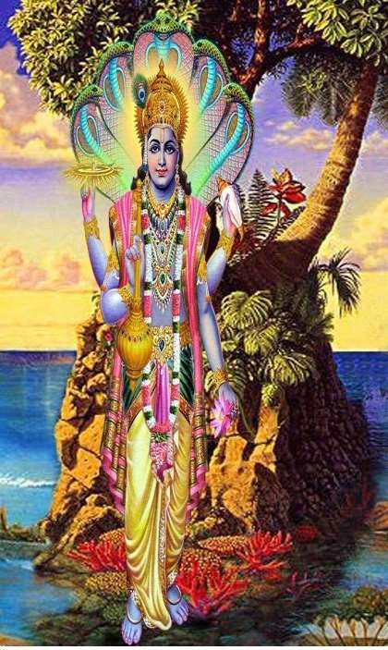
Oldest Purana: Vishnu Purana
It primarily centers around the Hindu god Vishnu and his avatars such
as Krishna.
Who is Vishnu?
Out of Vishnu this universe has arisen, in him its exists, he is the one who governs its existence and destruction, he is the universe.

Slide 47
18 PURANAS
Agni
Linga
Shiva
Bhrama
Padma
Skanda
Bhagavata
Kurma
Vamana
Brahmanda
Matsya
Varaha
Graruda
Narada
Vayu
Brahmavaivarta
Markandeya
Vishnu

Slide 48
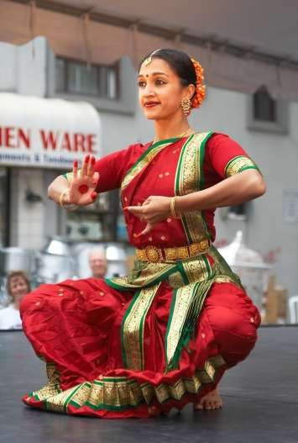
Impact of Puranas
Our Traditions and Value System
Our Festivals
Rituals (pujas)
Arts and Culture
Pilgrimage

Slide 49
Buddhist And Jain Literature in
Pali,Prakrit And Sanskrit
Buddhist texts are those religious texts which are part of the Buddhist tradition. The first Buddhist texts were initially passed on orally by Buddhist monastics, but were later written down and composed as manuscripts in various Indo-Aryan languages (such as Pali, Gāndhārī and Buddhist Hybrid Sanskrit) and collected into various Buddhist canons. These were then translated into other languages such as Buddhist Chinese (fójiào hànyǔ 佛教漢語) and Classical Tibetan as Buddhism spread outside of India.

Slide 50
Buddhist And Jain Literature in
Pali,Prakrit And Sanskrit
Buddhist texts can be categorized in a number of ways. The Western terms "scripture" and "canonical" are applied to Buddhism in inconsistent ways by Western scholars: for example, one authority refers to "scriptures and other canonical texts", while another says that scriptures can be categorized into canonical, commentarial, and pseudo-canonical. Buddhist traditions have generally divided these texts with their own categories and divisions, such as that between buddhavacana "word of the Buddha," many of which are known as "sutras," and other texts, such as shastras (treatises) or Abhidharma

Slide 51
Buddhist And Jain Literature in
Pali,Prakrit And Sanskrit
The religious books of the Jains and the Buddhists refer to historical persons or incidents. The earliest Buddhist works were written in Pali, which was spoken in Magadha and South Bihar.
The Buddhist works can be divided into the canonical and the non-canonical.
The canonical literature is best represented by the “Tripitakas”, that is, three baskets - Vinaya Pitaka, Sutta Pitaka and Abhidhamma Pitaka.
Vinaya Pitaka deals with rules and regulations of daily life. Sutta Pitaka contains dialogues and discourses on morality and deals with Dharma while Abhidhamma Pitaka deals with philosophy and metaphysics. It includes discourses on various subjects such as ethics, psychology, theories of knowledge and mataphysical problems.

Slide 52
Buddhist And Jain Literature in
Pali, Prakrit And Sanskrit
The non-canonical literature is best represented by the Jatakas. Jatakas are the most interesting stories on the previous births of the Buddha.
Each birth story is called a Jataka. The Jatakas throw invaluable light on the social and economic conditions ranging from the sixth century BC to the second century BC

Slide 53
Buddhist And Jain Literature in
Pali,Prakrit And Sanskrit
The Jain texts were written in Prakrit and were finally compiled in the sixth century AD in Valabhi in Gujarat. The important works are known as Angas, Upangas, Prakirnas, Chhedab Sutras and Malasutras.
Among the important Jain scholars, reference may be made to Haribhadra Suri, (eighth century AD) and Hemchandra Suri, (twelfth century AD).
Jainism helped in the growth of a rich literature comprising poetry, philosophy and grammar. These works contain many passages which help us to reconstruct the political history of eastern Uttar Pradesh and Bihar. The Jain texts refer repeatedly to trade and traders

Slide 54
Kautilya’s Arthashastra
Kautilya’s Arthashastra is an important treatise of the Mauryan times. It reflects the state of society and economy at that time and provides rich material for the study of ancient Indian polity and economy.

Slide 55
Kautilya’s Arthashastra
Kautilya: Kautilya is believed to be the chief adivser of Chandragupta Maurya.
Kautilya’s Arthashtra, a book on statecraft was written in the Maurya period in 4th century B.C.
The text was divided into 15chapters known as books. Different books deal with different subject matters.
Polity
Economy
Society
The king’s duties, the code of conduct of officers, agriculture and industry, taxation, the inter-state relations etc. were all detailed in the work.

Slide 56
Kautilya’s Arthashastra
Kautilya mentioned seven elements essential for a state namely:-
  Swami –(King)
  Janapada –(People)
  Amatya –(Ministers)
  Danda –(Sovereignty)
  Kosha –(Treasury)
  Durga –(Fort-Defence)
  Mitra –(Foreign Relations)

Slide 57
Kautilya’s Arthashastra
Kautilya’s Arthashastra regards the king to be the key in the working of the state administrative machinery.
  Education of the princes
  Duties of the king
  Selection of ministers
  Organisation of the different departments of the state
  Justice
  Taxation
  Foreign policy etc

Slide 58
Kautilya’s Arthashastra
Kautilya separated ethics from politics.
  He was of the view that the king may resort to ruthless approach for the security and safety of the empire.
  But this does not mean that the king was immoral.
  Kautilya lays much stress on morality in the personal
life of the king.
  King should have full control over his senses viz., lust, anger, greed, vanity, haughtiness and pleasure, because they have often brought the downfall of various kingdoms.

Slide 59
Kautilya’s Arthashastra
Kautilya’s work is far more varied-and entertaining-than usual accounts of its indication.
He mixes the harsh pragmatism for which he is famed with compassion for the poor, for slaves,and for women.
He reveals the imagination of a romancer in imagining all manner of scenarios which can hardly have been common place in real life.

Slide 60
Kautilya’s Arthashastra
Kautilya has laid down the ideals of kingship thus. “In the happiness of his subjects lies his happiness, in
their welfare, his welfare, what pleases him, he shall not consider as good, but whatever pleases his subjects he shall consider as good.”
Far from being single-mindedly aimed at preserving the monarch’s power for its own sake, the Arthasastra requires the ruler to benefit and protect his citizens, including the peasants, whom Kautilya correctly believes to be the ultimate source of the prosperity of the kingdom.

Slide 61
Famous Sanskrit Authors
The Gupta period was India’s golden age of culture and one of the greatest and most glorious times. The Gupta kings patronized the classical Sanskrit literature.
They helped liberally the scholars and poets of Sanskrit. This enriched the Sanskrit langauge. In fact Sanskrit language became the language of cultured and educated people.
Many great poets, dramatists and scholars appeared during this period and works in Sanskrit reached great heights.

Slide 62
Famous Sanskrit Authors
1. Kalidas: Poet Kalidas wrote many beautiful poems and plays. His works in Sanskrit are considered the gems of Literature. He wrote passionate plays and poems. His wonderful skill is exhibited in his poem Meghaduta, Ritusambara. Kumar Sambhavam and Raghuvamsha. His plays are Abhijan Shakuntalam, Vikramorvashi and Malvikaganimithram.
2. Vishakhdutta: Vishakhdutta was another great play writer of this period. He wrote two great historical plays like- Mudra Rakshas and Dev Chandra Gupta.
3. Shudraka: He wrote an exciting play Mrichchha Katikam or the Toy Cart. It is a great source of socio-cultural conditions of that time.

Slide 63
Famous Sanskrit Authors
4. Harisena: Among the great poets and play writers of the Gupta period was Harisena. He wrote poems praising the valour of Samudra Gupta. It is inscribed on Allahabad pillar.
5. Bhasa: He wrote thirteen plays which echo the lifestyle of the era along with its prevalent beliefs and culture.

Slide 64
Telugu Literature
The Vijayanagara period was the golden age of Telugu literature. Nachana Somanatha, a court poet of Bukka I, produced a poetical work titled Uttaraharivamsam.
Krishnadevaraya (1509-1529), the greatest of the Vijayanagara emperors, was a poet of great merit. His work Amukta Malyada is regarded as an excellent prabandha in Telugu literature.
Eight Telugu literary luminaries, popularly known as ashtadiggajas adorned his court. Among them, Allasani Peddana, the author of Manucharitram, was the greatest. He was known as Andhra kavitapitamaha.
The other seven poets of the group were Nandi Timmana, the author of Parijathapaharanam, Madayagari Mallana, Dhurjati, Ayyalaraju Ramabhadra Kavi, Pingali Surana, Ramaraja Bhushana and Tenali Ramakrishna

Slide 65
Telugu Literature
Ramakrishna was the author of Panduranga Mahatmayam which was considered one of the greatest poetical works of Telugu literature.
Ramarajabhushana was the author of Vasucharitram. He was also known as Bhattumurti. His other works include Narasabhupaliyam and Harishchandra Nalopakhyanam

Slide 66
Kannada Literature
Kannada literature, also spelled Kannaḍa, also called Kanarese, the literature written in Kannada, which, like the other languages of South India, is of the Dravidian family.
The earliest records in Kannada are inscriptions dating from the 6th century AD onward. The earliest literary work is the Kavirājamārga (c. AD 850), a treatise on poetics based on a Sanskrit model. Nearly all of the extant early texts in Kannada are poems on religious subjects written by Jaina authors. One of the most remarkable of these is the 12th-century Rāmāyaṇa of Abhinava Pampa; this work is a Jain version of the famous epic poem of the same name.

Slide 67
Kannada Literature
After the 12th century the Hindu sect known as Liṅgāyat replaced Jainism as the most important religious influence on Kannada literature. (The Liṅgāyats worship Śiva as the only deity.) Most Liṅgāyat works are simple in style, and many were meant to be sung.
The most popular works were the Vacanakāvyas, which were devotional poems to Śiva written in rhythmic prose. The earliest work in Kannada that may be termed a novel is Nemicandra’s Līlāvatī (1370), a love story involving a prince and a princess.

Slide 68
Kannada Literature
One of the most famous Kannada works is the Rājaśekharavilāsa, a fictional tale written in 1657 by Ṣaḍakṣaradeva in verse interspersed with prose. This work is a morality tale in which the divine intervention of Śiva saves a royal family from self-inflicted tragedy in their efforts to uphold the law.
Twentieth-century Kannada literature, like other Indian literatures, has modeled itself on European forms, especially the novel and short story.

Slide 69
Malayalam Literature
Malayalam literature (മലയാള സാഹിത്യം) comprises those literary texts written in Malayalam, a South-Dravidian language spoken in the Indian state of Kerala.
The earliest known literary work in Malayalam is Ramacharitam, an epic poem written by Cheeraman in 1198 CE. But it is highly influenced by Tamil language, as well as much distinct from modern Malayalam. In the subsequent centuries, besides a popular pattu ("song") literature, the manipravalam poetry also flourished. Manipravalam (translates "ruby coral") style consisted of poetry in an admixture of Malayalam and Sanskrit

Slide 70
Malayalam Literature
Bhasa Kautilya, a commentary on Arthashastra and Kokasandisan are two great works. Rama Panikkar and Ramanuj are well known authors of Malayalam literature. Though it developed much later compared to other South Indian languages, Malayalam has made a mark as a powerful medium of expression

Slide 71
TAMIL OR SANGAMA LITERATURE
Tamil as a written language was known since the beginning of the Christian era. It is, therefore, no wonder that considerable Sangama literature was produced in the early four centuries of the Christian era, although it was finally compiled by 600 AD.
Poets who in these assemblies were patronised by kings and chieftains produced the Sangama literature over a period of three to four centuries. Poets, bards and writers, authors came from various parts of South India to Madurai.
Such assemblies were called “Sangamas”, and the literature produced in these assemblies was called “Sangama literature

Slide 72
TAMIL OR SANGAMA LITERATURE
Tamil literature has a rich and long literary tradition spanning more than two thousand years.
Contributors to the Tamil literature are mainly from Tamil people from South India, including the land now comprising Tamil Nadu, Kerala, Sri Lankan Tamils from Sri Lanka, as well as the Tamil diaspora.
The history of Tamil literature follows the history of Tamil Nadu, closely following the social, economical, political and cultural trends of various periods.
.

Slide 73
TAMIL OR SANGAMA LITERATURE
The early Sangam literature, dated before 300 BCE, contain anthologies of various poets dealing with many aspects of life, including love, war, social values and religion.
This was followed by the early epics and moral literature,authoredby Shaivite Vaishnavite Jain and Buddhist authors and poets lasting up to the 5th century CE.
From the 6th to 12th century CE, the Tamil devotional poems written by Nayanmars (sages of Shaivism) and Alvars (sages of Vaishnavism), heralded the great Bhakti movement which later engulfed the entire Indian subcontinent.

Slide 74
TAMIL OR SANGAMA LITERATURE
It is during this era that some of the grandest of Tamil literary classics like Kambaramayanam and Periya Puranam were authored and many poets were patronized by the imperial Chola and Pandya empires. The later medieval period saw many assorted minor literary works and also contributions by a few Muslim and European authors.
There are about 30,000 lines of poetry, which are arranged in eight anthologies called Ettuttokoi. There are two main groups – the Patinenkil Kcollections) and Pattupattu (the ten songs).

Slide 75
TAMIL OR SANGAMA LITERATURE
The former is generally assumed to be older than the latter, and considered to be of more historical importance. Thiruvallurar’s work ‘Kural’ is divided into three parts.anakku (the eighteen lower collections) and Pattupattu (the ten songs).
The former is generally assumed to be older than the latter, and considered to be of more historical importance. Thiruvallurar’s work ‘Kural’ is divided into three parts. The first part deals with the epics, the second part with polity and government and the third part with love.

Slide 76
Northern Indian Languages &
Literature
Languages were evolving at two levels: The spoken language and The written language. The old Brahmi script of the Ashoka days had undergone a great change. The alphabets during Ashoka՚s period were uneven in size but by the time of Harsha, the letters had become of the same size and were regular, presenting the picture of a cultivated hand.
The studies have indicated that all the scripts of present northern Indian languages, except that of Urdu, have had their origin in old Brahmi. If we compare the scripts of Gujarati, Hindi and Punjabi, we can easily understand this change.
As for the spoken word, there are over 200 languages or dialects spoken in India at present. Some are widely used while others are limited to a particular area. Out of all these, only twenty-two have found their way into our Constitution.

Slide 77
Persian and Urdu
Urdu emerged as an independent language towards the end of the 4th century AD.
Arabic and Persian were introduced in India with the coming of the Turks and the Mongols. Persian remained the court language for many centuries. Urdu as a language was born out of the interaction between Hindi and Persian.
Originally it was a dialect but slowly it acquired all the features of a formal language when the authors started using Persian script. Urdu became more popular in the early eighteenth century.
People even wrote accounts of later Mughals in Urdu. Urdu was patronised by the Nawabs of Lucknow, who held symposiums in this language. Slowly it became quite popular. Pakistan has adopted Urdu as the state language.

Slide 78
Hindi Literature
There was a tremendous growth of regional languages like Hindi, Bengali, Assamese, Oriya, Marathi and Gujarati during this time.
The emergence of all these languages resulted in the decline of Sanskrit as they came to be used as the medium through which the administrative machinery functioned. We have already noted the various dialects that developed in northern and western India.
Prithviraj Raso is supposed to be the first book in Hindi language. It is an account of exploits of Prithvi Raj Chauhan.
Hindi literature looked to Sanskrit classics for guidance and Bharata՚s Natyashastra was kept in mind by Hindi writers. As its influence reached the north, it started affecting the prose and poetry that were being composed in Hindi.

Slide 79
Hindi Literature
Hindi evolved during the Apabhramsha stage between the 7th and 8th centuries A. D. and the 14th C.
It was patronised by the Rajput rulers as it glorified chiralry and poetry. The most famous figures from this period were Kabir and Tulsidas. All the above mentioned Hindi poets, except Kabir, expressed their sentiments essentially to satisfy their own devotional instincts.

Slide 80
Hindi Language Makes Progress in Modern Period
The development of modern language states at the end of the 18th century
The main writers of this period were Sadasukh Lal and Enshallah Khan. Bhartendu Harishchandra also strengthened Hindi language. Similarly, Raja Lakshman Singh translated Shakuntala into Hindi. Hindi continued to develop in adverse circumstances as the office work was done in Urdu.

Slide 81
Hindi Literature
Bhartendu Harish Chandra, Mahavira Prasad Dwivedi, Ramchandra Shukla and Shyam Sunder Das were the main among the prose writers of Hindi literature. Jai Shanker Prasad, Maithalisharan Gupta, Sumitranandan Pant, SuryakantTripathi ‘Nirala’ , MahadeviVerma, Ramdhari Singh ‘Dinkar’ and Haribans Rai ‘Bacchan’ made great contribution to the development of Hindi poetry.

Slide 82
Video Link
Youtube/other Video Links:
https://www.youtube.com/watch?v=zcRn83BOEJc
https://www.youtube.com/watch?v=Cuc04Og5UAo

Slide 83
Daily Quiz
What do the 4 Vedas contain?
How was Malayalam Literature developed?
What is the importance of Koutilya’s Arthashastra?

Slide 84
MCQ s
1. Which of the following Vedic literature where the Varna system was discussed?
A. Rigveda
B. Samaveda
C. Yajurveda
D. Atharvaveda
2. The Arthashastra of Kautilya is a
(A) Play about Chandragupta Maurya
(B) Biography
(C) History of Chandragupta Maurya
(D) Book on Principles of Government
3. The Brahmi Script was first deciphered by letters inscribed on
(A) Stone tablets
(B) Seal
(C) Pillars
(D) Coins
4. Which is the script of Indus Valley Civilization?
Tamil.
Kharshthi.
Unknown.
Brahmi

Slide 85
Assignment
Explain the evolution of Brahmi Script in Ancient India.
Critically analyse the ancient India Tales of Mahabharata and Ramayan.
Give a brief overview of Famous authors of Sanskrit in Ancient India.

Slide 86
Expected Questions for University Exam
1. Briefly explain how many Puranas are there ? Name few characteristics of Puranas.
2. Explain what do the Jataka Tales tell us about.
3. Discuss the importance of Upanishads.

Slide 87
Old Question papers
Subject introduced for the first time!!

Slide 88
Summary
This unit gives overview on how different scripts and languages evolved in ancient India.

Slide 89
References
References :
1. V. Sivaramakrishna (Ed.), Cultural Heritage of India-Course Material, Bharatiya Vidya Bhavan, Mumbai, 5th Edition, 2014
2. S. Baliyan, Indian Art and Culture, Oxford University Press, India
3. Swami Jitatmanand, Modern Physics and Vedant, Bharatiya Vidya Bhavan
4. Romila Thapar, Readings In Early Indian History Oxford University Press , India

